Slide 1
GASB 68 ERS- Agent Multiple Plan Diane E. Scott, CPA, CGMA Summer 2015

Slide 2
ERS Retirement Employer Portal
Project Update

Slide 3
Project Schedule
ERS Retirement Employer Portal Design Requirements- Early 2016
Transition to New Employer Portal May 2017
New data elements will be required
Your IT Vendor will need to be involved

Slide 4
What is in my packet?
Overall memo related to audit approach and summary of packet
GASB Statement 68 Report for ERS prepared by Actuary
Schedule of Changes in Fiduciary Net Position by Employer – (Specified Element Report)
SOC 1 Type 2 report
Draft Note Disclosures for an agent employer
Employer specific valuation info and journal entries with certification letter from Actuary

Slide 5
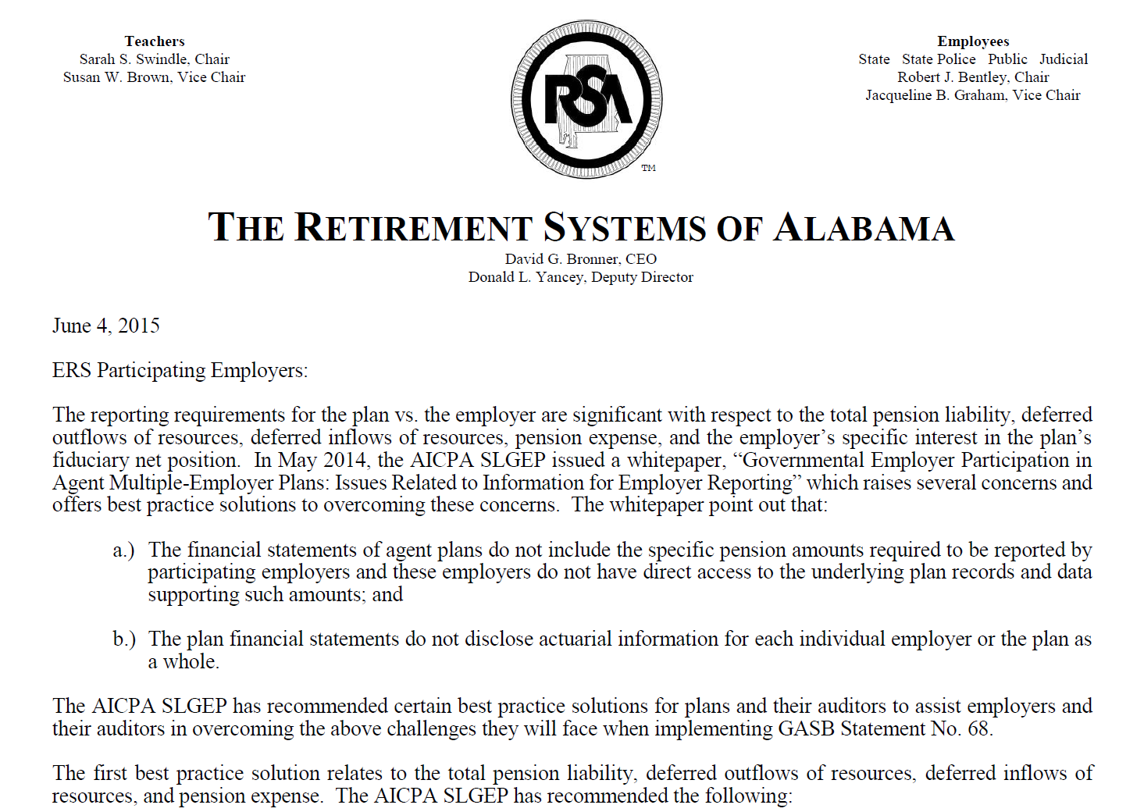
Overall Memo on Audit Approach

Slide 6
Overall Memo on Audit Approach
AICPA Whitepapers published by State and Local Government Expert Panel
Governmental Employer Participation in Agent Multiple-Employer Plans: Issues Related to Information for Employer Reporting
Description of Schedule of Changes in Fiduciary Net Position by Employer
List of all reports provided
Note: Provide a copy of all materials to your auditor
Notes:
You will be concerned with the Cost Sharing Multiple-Employer Plan implementation. If you start to talk with friends who are responsible for implementation of an ERS employer, your information and process will be different than what they are experiencing. Your reports will look different and your disclosure will look different.

Slide 7
GASB Statement 68
Each Local employer in ERS stands alone. Benefit payments will be made to the extent your plan has assets from which benefits can be paid. If the assets in your plan are depleted, the responsibility for funding future benefit payments is the employer, not RSA. Because of this, GASB Statement 68 replaces the financial reporting requirements under GASB Statement 27 for participating employers in public pension plans. Major financial reporting and accounting changes for agent multiple employer plans include recognizing and reporting:
Liability for your net pension liability (if over 100% funded, record an asset)
Your pension related deferrals and collective pension expense
Deferred Inflows and Outflows of Resources (GASB 71 related to Employer Contributions)
Additional Note Disclosures and Required Supplementary Information (RSI)

Slide 8
Schedule of Changes in Fiduciary Net Position by Employer

Slide 9
Schedule of Changes in Fiduciary Net Position by Employer
Specified Element Report
Audit opinion by RSA auditors (pages 1-2 )
Each employer’s change in fiduciary net position (pages 3-17 )
Notes to schedules (pages 18-21)

Slide 10
Contribution – Employee (Member)
See page 1 of GASB 68 Statement prepared specifically for your agency
Contribution- Employee (member) included in Changes in Plan Fiduciary Net Position consist of:
Member Contributions deducted from Member’s paycheck and remitted monthly via CRA upload to RSA
Member Contributions submitted based upon error service or review of annual checklist
Purchases of Service submitted by Members
Less Refunds of Member Contributions or insufficient funds checks
Contributions- Employee are included on accrual basis, not cash basis

Slide 11
ERS Employer Rate
[ERS Rates are used as an example, each ERS employer has specific rates
and should use those for calculation purposes]
11.67%
9.79%
11.61%
9.71%

Slide 12
Contribution - Employer
See page 1 of GASB 68 Statement prepared specifically for your agency
Contribution- Employer included in Change in Plan Fiduciary Net Position consists of:
Employer Contributions related to the normal and accrued liability rates remitted monthly to RSA
Employer error service contributions related to normal and accrued liability rates
Employer lump sum payments
Less refund of employer contributions related to normal and accrued liability rates
Contributions- Employer are included on accrual basis, not cash basis

Slide 13
Contributions Used for Allocation Percentage
Total Contributions = Monthly ER Contributions + Error Service – Refunds + Lump Sum
Monthly Employer Contribution components not considered in calculating the Net Pension Liability: PRDB and Admin Expense
Formula: Monthly ER Contributions x (Normal + Accrued Liability Rate) / Total Employer Rate

Slide 14
Investment Income
Investments are only component of Agent Multiple Employer Plan that are pooled
Investment Income is allocated to participating employers based upon percent earned for Fiscal Year rounded to nearest ¼%. For FY 2014, rate used = 12%
Calculation Method:
Beginning of year market value X rate
+ Cash flow (excluding Lump Sum Employer Contribution) x rate x 50%
+ Lump sum employer contribution x rate raised to the power equal to # of days ERS had the contribution divided by 365

Slide 15
A-lign SOC 1 Type 2 Report

Slide 16
Report on Management’s Description of Retirement Systems of Alabama’s System and the Suitability of the Design and Operating Effectiveness of Controls
SOC 1 Type 2 report for period Jan 1, 2014—Sept 30, 2014 (to be prepared annually)
Audit firm: A-lign CPA’s
Controls reviewed and tested around following :
Contributions/Enrollments
Investments
Disbursements for benefits
Valuations and Census Data

Slide 17
SOC 1 Type 2 Report—Why do I need this?
Provide to your auditors
Complimentary User Entity Controls section—pages 19-20
Review your organization’s controls around the following user entity controls:
Enrollment
Contributions
Census Data
Distributions
IT General Controls

Slide 18
Examples of User Entity Controls
Enrollment-providing timely enrollment forms to new employees
Annual checklists—promptly process, review, correct and certify to RSA the completeness of the Annual Checklist
Completion of non-enrollee forms
Timely and accurate termination of employment and last contribution remitted

Slide 19
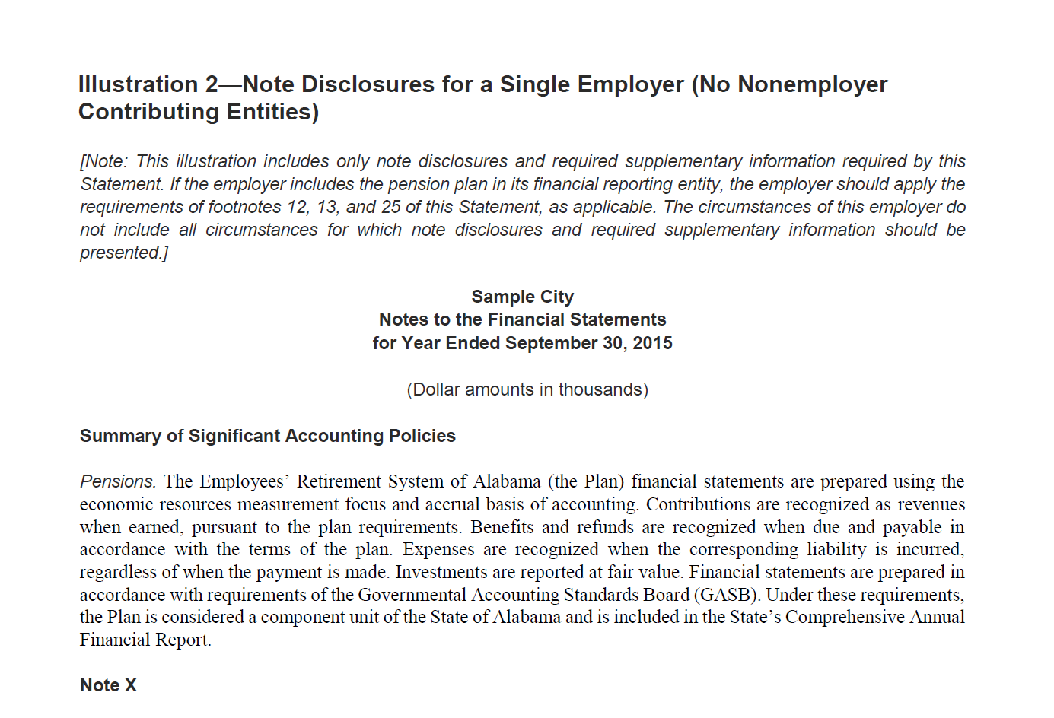
Note Disclosures and Required Supplementary Information

Slide 20
Note Disclosures and Required Supplementary Information
Follows requirements of GASB 68
Contains disclosures specific to ERS for your September 30, 2015 financials
These disclosures as presented have been run through a GAAP disclosure checklist relative to GASB 68 and 71 disclosures
Note: Summary of Significant Accounting Policies—see suggested language
Note X—this is your note that gives more specific information about the ERS plan
References to “See Detail Table or Report”

Slide 21
Important Dates
Valuation Date: September 30, 2013
Measurement Date: September 30, 2014
Measurement Period: Oct 1, 2013-Sept 30, 2014
Financial Statement Date: September 30, 2015
Net Pension Liability for 9/30/2013 was rolled forward to 9/30/2014 using standard roll-forward procedures by actuary

Slide 22
Note Disclosures and Required Supplementary Information (RSI)
Schedule of Change in Net Pension Liability and Related Ratios
GASB 68, paragraph 46 a and b
Covered employee payroll
Not pensionable payroll
Covered employee payroll during Measurement Period (FY2014)
Schedule of Contributions
GASB 68, paragraph 46c
Contributions only for normal and accrued liability component of employer rate
Covered employee payroll—during fiscal year of your audit report (FY2015)

Slide 23
Schedules of Required Supplementary Information
Schedule of Changes in the City’s Net Pension Liability and Related Ratios
Last 10 Fiscal Years
(Dollar amounts in thousands)
 |  |  |  |  |  |  |  |  | 2015 |  | 2016 |  | 2017 |  | 2018 |  | 2019 |  | 2020 |  | 2021 |  | 2022 |  | 2023 |  | 2024
 | Total Pension Liability
 | Service Cost |  |  |  |  |  |  |  | $ |  | $ |  | $ |  | $ |  | $ |  | $ |  | $ |  | $ |  | $ |  | $
 | Interest |  |  |  |  |  |  |  | $ |  | $ |  | $ |  | $ |  | $ |  | $ |  | $ |  | $ |  | $ |  | $
 | Changes of benefit terms |  |  |  |  |  |  |  | - |  | - |  | - |  | - |  | - |  | - |  | - |  | - |  | - |  | -
 | Differences between expected and actual experience |  |  |  |  |  |  |  | $ |  | $ |  | $ |  | $ |  | $ |  | $ |  | $ |  | $ |  | $ |  | $
 | Changes in assumptions |  |  |  |  |  |  |  | - |  | - |  | - |  | - |  | - |  | - |  | - |  | - |  | - |  | -
 | Benefit payments, including refunds of employee contributions |  |  |  |  |  |  |  | $ |  | $ |  | $ |  | $ |  | $ |  | $ |  | $ |  | $ |  | $ |  | $
 | Net change in total pension liability |  |  |  |  |  |  |  | $ |  | $ |  | $ |  | $ |  | $ |  | $ |  | $ |  | $ |  | $ |  | $
 | Total pension liability -- beginning |  |  |  |  |  |  |  | $ |  | $ |  | $ |  | $ |  | $ |  | $ |  | $ |  | $ |  | $ |  | $
 | Total pension liability -- ending(a) |  |  |  |  |  |  |  | $ |  | $ |  | $ |  | $ |  | $ |  | $ |  | $ |  | $ |  | $ |  | $
 | Plan fiduciary net position
 | Contributions -- employer |  |  |  |  |  |  |  | $ |  | $ |  | $ |  | $ |  | $ |  | $ |  | $ |  | $ |  | $ |  | $
 | Contributions -- employee |  |  |  |  |  |  |  | $ |  | $ |  | $ |  | $ |  | $ |  | $ |  | $ |  | $ |  | $ |  | $
 | Net investment income |  |  |  |  |  |  |  | $ |  | $ |  | $ |  | $ |  | $ |  | $ |  | $ |  | $ |  | $ |  | $
 | Benefit payments, including refunds of employee contributions |  |  |  |  |  |  |  | $ |  | $ |  | $ |  | $ |  | $ |  | $ |  | $ |  | $ |  | $ |  | $
 | Administrative expense |  |  |  |  |  |  |  | $ |  | $ |  | $ |  | $ |  | $ |  | $ |  | $ |  | $ |  | $ |  | $
 | Other |  |  |  |  |  |  |  | $ |  | $ |  | $ |  | $ |  | $ |  | $ |  | $ |  | $ |  | $ |  | $
 | Net change in plan fiduciary net position |  |  |  |  |  |  |  | $ |  | $ |  | $ |  | $ |  | $ |  | $ |  | $ |  | $ |  | $ |  | $
 | Plan fiduciary net position -- beginning |  |  |  |  |  |  |  | $ |  | $ |  | $ |  | $ |  | $ |  | $ |  | $ |  | $ |  | $ |  | $
 | Plan fiduciary net position -- ending (b) |  |  |  |  |  |  |  | $ |  | $ |  | $ |  | $ |  | $ |  | $ |  | $ |  | $ |  | $ |  | $
 | City's net position liability -- ending (a)-(b) |  |  |  |  |  |  |  | $ |  | $ |  | $ |  | $ |  | $ |  | $ |  | $ |  | $ |  | $ |  | $
 | Plan fiduciary net positon as a percentage of the
 | total pension liability |  |  |  |  |  |  |  | % |  | % |  | % |  | % |  | % |  | % |  | % |  | % |  | % |  | %
 | Covered-employee payroll
 | City's net pension liability as a percentage of |  |  |  |  |  |  |  | $ |  | $ |  | $ |  | $ |  | $ |  | $ |  | $ |  | $ |  | $ |  | $
 | covered-employee payroll |  |  |  |  |  |  |  | % |  | % |  | % |  | % |  | % |  | % |  | % |  | % |  | % |  | %
 |  | * The amounts presented for each fiscal year were determined as of 9/30.
 | Notes to Schedule:
 | A: Per question and answer 210 of the GASB 68 Implementation Guide, covered employee payroll IS NOT pensionable payroll of covered employees,
 | but the total payroll of those employees who are participating in the pension plan. Also, per question and answer 211, the covered-employee payroll for
 | this RSI schedule (GASB 68 paragraph 81a) is for the measurement period, which for the 9/30/2015 year is 10/1/2013--9/30/2014.
This schedule is presented to illustrate the requirement to show information for 10 years. However, until a full 10-year trend is compiled, governments should present information for those years for which information is available.

Slide 24
Schedule of Contributions
Last 10 Fiscal Years
( Dollar amounts in thousands)
 |  |  |  |  |  |  | 2015 |  | 2016 |  | 2017 |  | 2018 |  | 2019 |  | 2020 |  | 2021 |  | 2022 |  | 2023 |  | 2024
 | Actuarially determined contribuitons |  |  |  |  |  | $ |  | $ |  | $ |  | $ |  | $ |  | $ |  | $ |  | $ |  | $ |  | $
 | Contributions in relation to the actuarially
 | determined contribution |  |  |  |  |  | $ |  | $ |  | $ |  | $ |  | $ |  | $ |  | $ |  | $ |  | $ |  | $
 | Contribution deficiency (excess) |  |  |  |  |  | $ - |  | $ - |  | $ - |  | $ - |  | $ - |  | $ - |  | $ - |  | $ - |  | $ - |  | $ -
 | Covered-employee payroll |  |  |  |  |  | $ |  | $ |  | $ |  | $ |  | $ |  | $ |  | $ |  | $ |  | $ |  | $
 | Contributions as a percentage of covered- |  |  |  |  |  | % |  | % |  | % |  | % |  | % |  | % |  | % |  | % |  | % |  | %
 | employee payroll
 | Notes to Schedule:
 | A: Per question and answer 210 of the GASB 68 Implementation Guide, covered employee payroll IS NOT pensionable payroll of covered employees,
 | but the total payroll of those employees who are participating in the pension plan. Also, per question and answer 211, the covered-employee payroll for
 | this RSI schedule (GASB 68 paragraph 81b) is for the reporting fiscal year, which for the 9/30/2015 year is 10/1/2014--9/30/2015.
 | B: Per question and answer 212 of the GASB 68 Implementation Guide, the amount of contractually required contributions is equal to the amount that would be
 | recognized as additions from the employer's contributions in the pension plan's schedule of changes in fiduciary net position during the period that
 | coincides with the employer's fiscal year. For participation in the ERS, this WOULD NOT include amounts paid to ERS for the Pre-retirement Death Benefit,
 | Term Life Insurance or Administrative Expenses. It does include the amounts paid to ERS for the Employer's portion of the Normal Cost and Accrued Liability.
 | Actuarially determined contribution rates were calculated as of September 30, two years prior to th eendo of the fiscal year in which contributions are reported.
 | Contributions for fiscal year 2015 were based on the September 30, 2012 actuarial valuation
 | Methods and assumptions used to determine contribution rates:
 | Actuarial cost method |  |  |  | Entry Age
 | Amortization method |  |  |  | Level percent closed
 | Remaining amortization period |  |  |  | Within 29.9 years- varies by employer
 | Asset valuation method |  |  |  | Five year smoothed market
 | Inflation |  |  |  | 3.00%
 | Salary increases |  |  |  | 3.75-7.25%, including inflation
 | Investment rate of return |  |  |  | 8.00%, net of pension plan investment expense, including inflation
 | Other information:
 | On January 1, 2013, benefit terms were modified to base employee pensions on a final five-year average salary instead
 | of a final three-year salary.

Slide 25
Covered/Pensionable Payroll
Example:
Employee 1
Employee 2
Employee 3
Annual Salary: $500,000
Annual Salary: $150,000
Works 5 hours per month
Pensionable Payroll*: $260,000
Pensionable Payroll: $150,000
Pensionable Payroll: $0
Covered Payroll: $500,000
Covered Payroll: $150,000
Covered Payroll: $0
* Per IRS Code 26 U.S.C. 401(a)(17), 2014 Annual Pensionable Compensation Limit is $260,000. For 2015- $265,000.

Slide 26
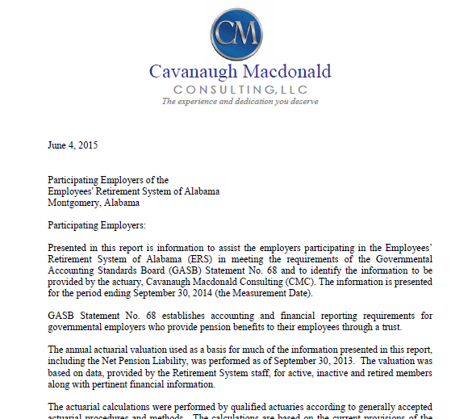
Employer Valuation Data—Actuarial Certification Letter

Slide 27
Employer Valuation Data
Certification Letter from Actuary
Pages 1-3—Information necessary for note disclosures
Page 4-5—Information for Required Supplementary Schedule
Page 6—Agency specific journal entries
First two entries record the beginning amounts of the liability and deferred outflow of resources as of the implementation date (10/1/2014). These entries are only made at implementation.
Entry 3 records amounts necessary to amortize the deferred inflows/outflows and record pension expense
Entry 4 records the deferred outflow for current year employer contributions in accordance with GASB 71

Slide 28
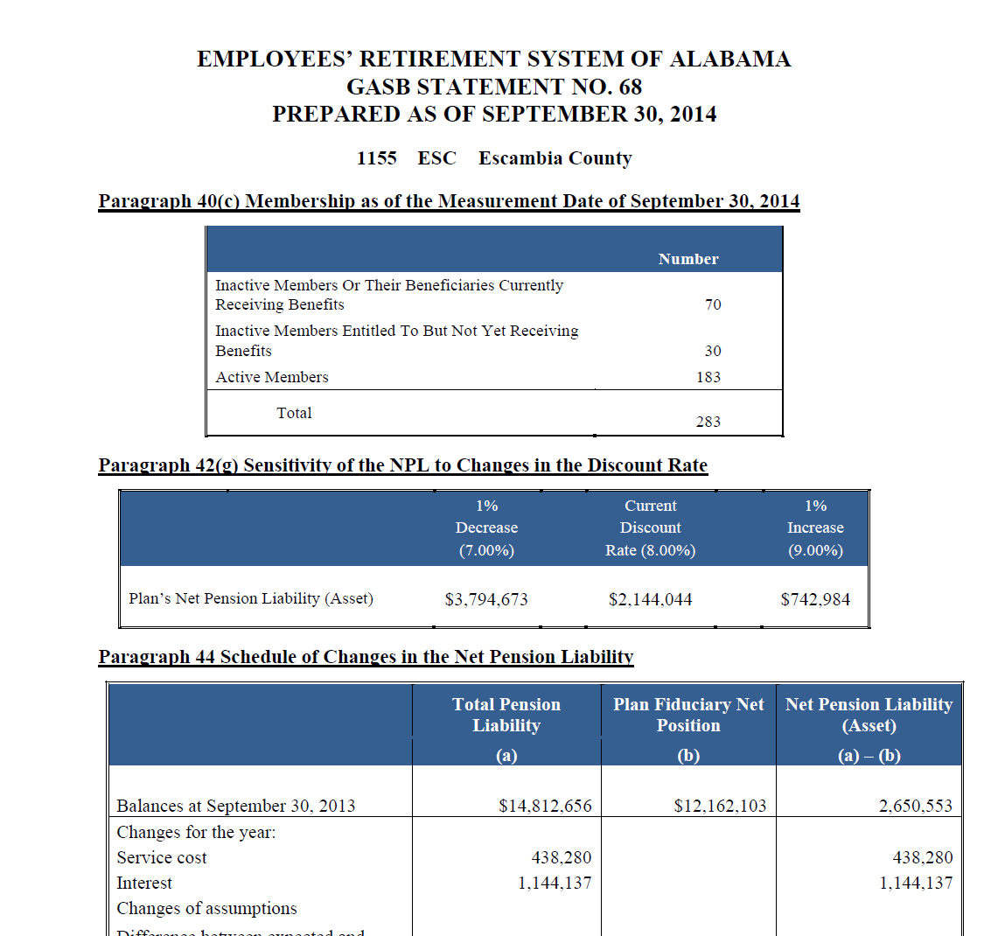
Employer Valuation Data-Footnotes
Pages 1 - 3
XXXX
Unit Code
Name

Slide 29
SEIR- Single Equivalent Interest Rate
GASB 68, paragraphs 26 and 42
Cavanaugh Macdonald Consulting, LLC GASB 68 Report, pages 3 and 5
Long-term Expected Rate of Return = 8%
Municipal Bond Index Rate @ Measurement Date = 4.13%
Methodology used for cash flow
Current member rates
Employer contributions in accordance with funding policy adopted by ERS Board of Control (Actuarial Section of RSA CAFR or ERS Actuarial Valuation) see www.rsa-al.gov
Each Employer’s Fiduciary Net Position was sufficient to make all projected future benefit payments of current plan members
SEIR- Single Equivalent Interest Rate for all employers = 8%

Slide 30
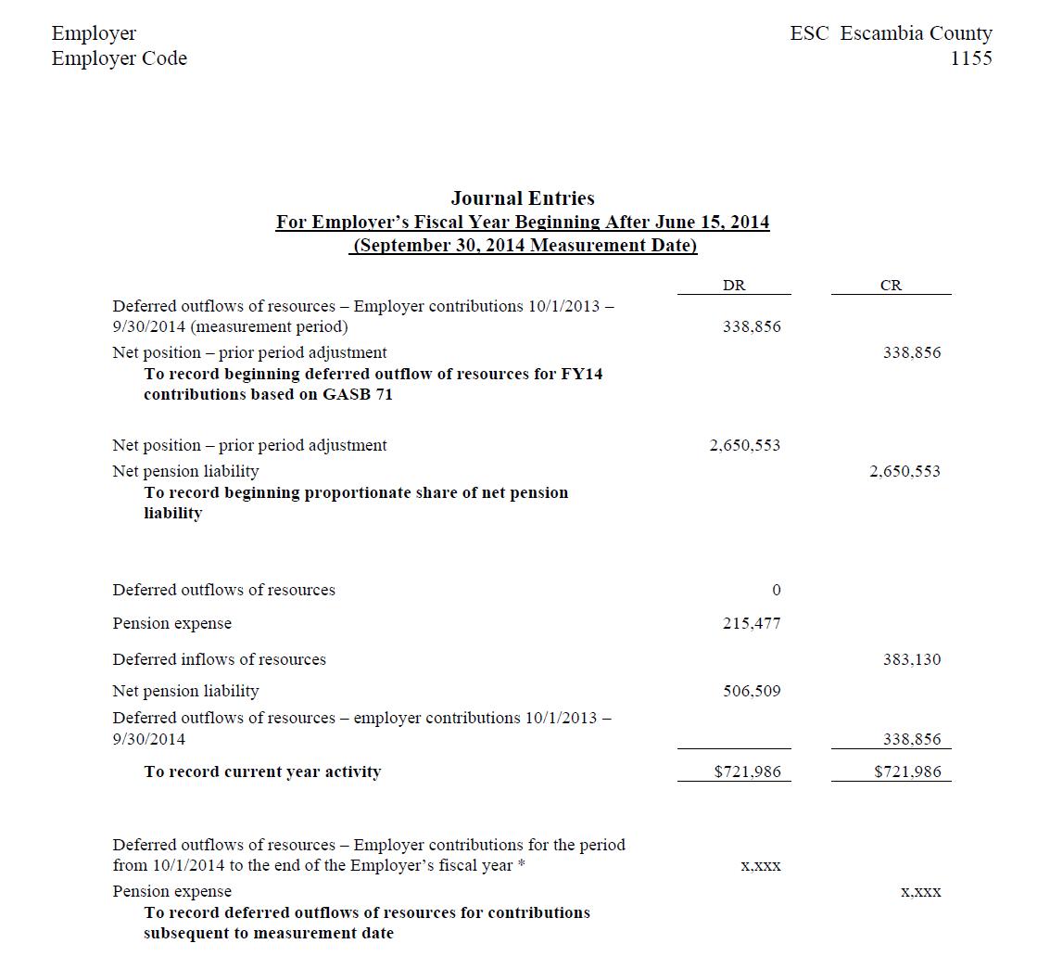
Employer Valuation Data—Journal Entries
Page 6
Unit Code Name
XXXX

Slide 31
Net Pension Liability Example Net Assets Remain Positive
XYZ City Statement of Net Assets
 | Before (in thousands) | After (in thousands)
Assets
Current Assets | $ 15,000 | $ 15,000
Deferred Outflows |  | 2,000
Capital Assets | 25,000 | 25,000
Total Assets | $ 40,000 | $ 42,000
Liabilities
Current Liabilities | $ 6,000 | $ 6,000
Net Pension Liability |  | 26,000
Deferred Inflows |  | 1,000
Total Liabilities | $6,000 | $ 33,000
Total Net Assets | $ 34,000 | $ 9,000

Slide 32
Net Pension Liability Example Net Assets are Negative
XYZ City Statement of Net Assets
 | Before (in thousands) | After (in thousands)
Assets
Current Assets | $ 15,000 | $ 15,000
Deferred Outflows |  | 2,000
Capital Assets | 25,000 | 25,000
Total Assets | $ 40,000 | $ 42,000
Liabilities
Current Liabilities | $ 6,000 | $ 6,000
Net Pension Liability |  | 44,000
Deferred Inflows |  | 1,000
Total Liabilities | $ 6,000 | $ 51,000
Total Net Assets | $ 34,000 | $ (9,000)

Slide 33
Deferred Inflows and Outflows of Resources
Economic & Demographic Gains and Losses
Changes in Economic & Demographic Assumptions and Inputs
Difference between projected and actual investment earnings
GASB 71—Deferred Outflow
Numbers 1 – 2 above are to be recognized over the expected service life of active and inactive plan members. Number 3 is to be recognized over a closed five year period.

Slide 34
Pension Expense
Under prior standards, employers report a pension expense equal to their contractually required annual contributions
Changes in the NPL will be reported either immediately as a pension expense or over a period of time as deferred outflows/inflows of resources.
FY 2014
Pension Expense = + Service Cost $xxxxxx
+ Interest on TPL xxxxxx
+ Changes in Plan Benefits Ø
- Member Contribution (xxxxx)
- Projected Earnings on Plan Investments (xxxxx)
- Expensed portion of current period differences (xxxxx)
between actual and projected earnings in
plan investments
-/+ Recognition of portion of (xxxxx)
deferred inflows/outflows
-/+ Transfer among employers (xxxxx) ___________
Pension Expense $XXXXX

Slide 35
What if my Year End is 6/30?
Book same entries for:
Prior Period Adjustment- Liability
Prior Period Adjustment- GASB 71- Record Deferred Outflows of Contributions during Measurement Period
Pension Expense and Amortization of Deferred Inflows/Outflows
For the GASB 71 entry, reclass Contributions from 9/30/14 – 6/30/15 using the following formula:
Monthly Employer Contribution x (Normal + Accrued liability components of employer rate)/ total employer rate, plus
Lump Sum Contribution made in period subsequent to the measurement date (100% of Lump Sum Contributions are applied to the liability)

Slide 36
What if my year end is 12/31?
Book same entries for
Prior Period Adjustment- Liability
Prior Period Adjustment- GASB 71- Record Deferred Outflows of Contributions during Measurement Period
Pension Expense and Amortization of Deferred Inflows/Outflows
For GASB 71 entry for Contribution from measurement date to year end, reclass Contributions from 9/30/14 – 12/31/15 using the following formula:
Monthly Employer Contribution x (Normal + Accrued liability components of employer rate)/ total employer rate, plus
Lump Sum Contribution made in period subsequent to the measurement date (100% of Lump Sum Contributions are applied to the liability)

Slide 37
What if my year end is 3/31?
Book same entries for
Prior Period Adjustment- Liability
Prior Period Adjustment- GASB 71- Record Deferred Outflows of Contributions during Measurement Period
Pension Expense and Amortization of Deferred Inflows/Outflows
For GASB 71 entry for Contribution from measurement date to year end, reclass Contributions from 9/30/14 – 3/31/15 using the following formula:
Monthly Employer Contribution x (Normal + Accrued liability components of employer rate)/ total employer rate, plus
Lump Sum Contribution made in period subsequent to the measurement date (100% of Lump Sum Contributions are applied to the liability)

Slide 38
What if my year end is another month?
Book same entries for
Prior Period Adjustment- Liability
Prior Period Adjustment- GASB 71- Record Deferred Outflows of Contributions during Measurement Period
Pension Expense and Amortization of Deferred Inflows/Outflows
For GASB 71 entry for Contribution from measurement date to year end, reclass Contributions from 9/30/14 to month end of your fiscal year using the following formula:
Monthly Employer Contribution x (Normal + Accrued liability components of employer rate)/ total employer rate, plus
Lump Sum Contribution made in period subsequent to the measurement date (100% of Lump Sum Contributions are applied to the liability)

Slide 39
Is this info on the RSA website?
Yes! www.rsa-al.gov/index.php/employers/financial-reports/gasb-68-reports/
ALL reports included in Packet are on RSA website except Employer Specific information and journal entries
To obtain another copy of Employer Valuation information and journal entries, call RSA
In future years, all reports will be available on website except the Employer Valuation information and journal entries which will be mailed prior to July 31

Slide 40
Employer Rate Notifications
Employer rates for a Fiscal Year are set based upon a valuation 2 years prior.
For FY 2016 (begins 10/1/15), the employer rate is set from the 9/30/13 valuation
The 9/30/2013 valuation was mailed to each agency in summer 2014.
There are rare instances when the rate may change prior to its effective date:
Oct 2014 Cola to be funded in FY 2016
Changes in assumptions specific to an agency such as declining payroll that require an increase to the rate
July prior to effective date of change, RSA will send a reminder letter related to appropriate rate to use 10/1

